Slide 1

Computer Networking Crash Course

Slide 2

Interactive Content
Notes:
Start at 1:32

Slide 3
What’s a computer?
A computer is a machine or device that performs processes, calculations and operations based on instructions provided by a software or hardware program. It is designed to execute applications and provides a variety of solutions by combining integrated hardware and software components. (Technopedia)
A computer is made up of multiple parts and components that facilitate user functionality. A computer has two primary categories:
Hardware: Physical structure that houses a computer's processor, memory, storage, communication ports and peripheral devices
Software: Includes operating system (OS) and software applications
Notes:
If you don’t know this, now is a good time to leave

Slide 4
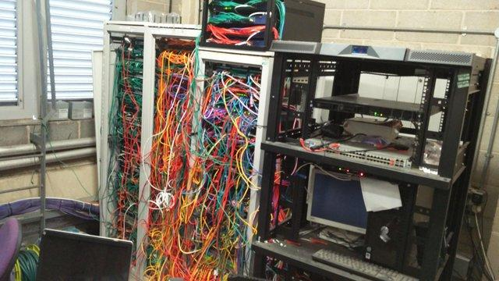
What’s a computer network?
Take a lotta computers. Hook em together. Now you have a computer network.

Slide 5
End of slide show, click to exit.

Slide 6
What’s a computer network?
A computer network is a set of computers connected together for the purpose of sharing resources. The most common resource shared today is connection to the Internet. Other shared resources can include a printer or a file server. The Internet itself can be considered a computer network. (Technopedia.com)
Resource examples: Netflix, email, Youtube, other tubes
All of these things require a lot of infrastructure to send packets from Google HQ all the way to your computer in rural SC.

Slide 7

Interactive Content
Notes:
Content such as Buster dropping from 1000 feet in the fucking air. Start at 4:40

Slide 8
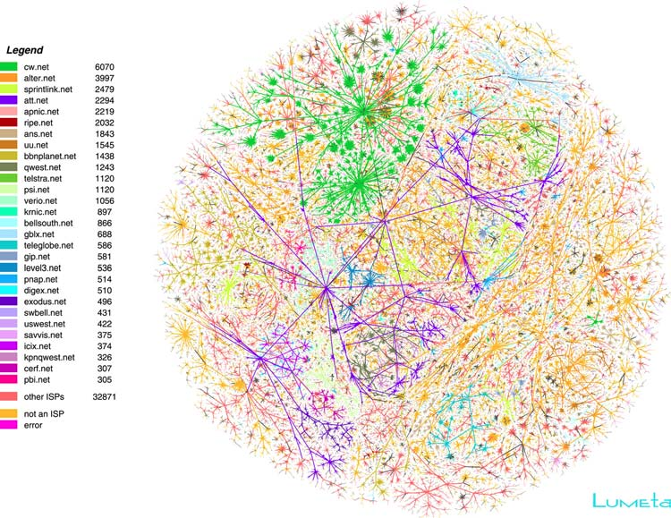
Internet Map

Slide 9
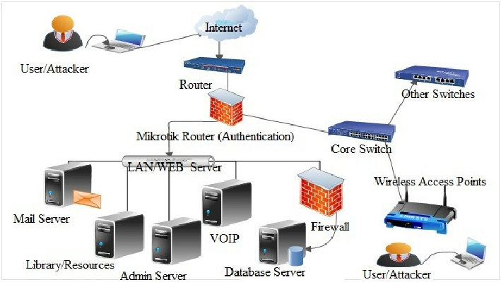
Corporate Network Topology

Slide 10
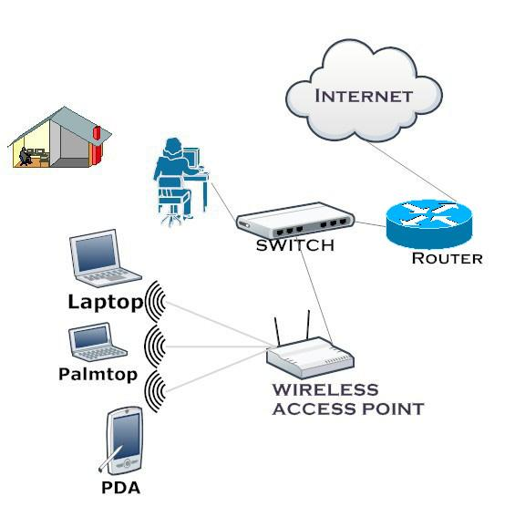
Home Network Topology

Slide 11
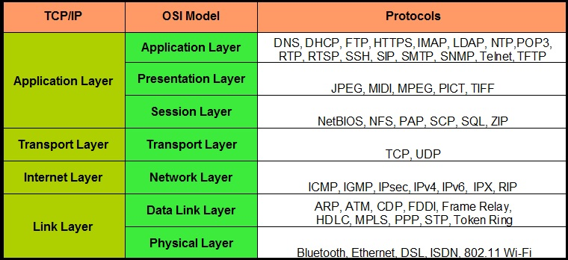
Network Layers
Notes:
RIP - routing information protocol
IPX - Some weird Novell protocol
IGMP - The Internet Group Management Protocol (IGMP) used by multicast

Slide 12
What’s a packet?
A packet is a small amount of data sent over a network, such as a LAN or the Internet. Similar to a real-life package, each packet includes a source and destination as well as the content (or data) being transferred. When the packets reach their destination, they are reassembled into a single file or other contiguous block of data. (Techterms.com)
Classic Analogy:
A packet is like a piece of mail
Has sender’s address and receiver’s address
Contains arbitrary content encapsulated within packet “headers”
Unlike a piece of mail, does not have to conform to U.S. postal regulations
However, does have to conform to the norms of networking. In most cases, invalid packets will be dropped.

Slide 13
Physical Layer
Physical layer of your network
Wifi, Ethernet, Bluetooth, etc
“Bits over the wire”

Slide 14
Data Link Layer
Uses MAC Addresses for identifying devices (Layer 2)
What’s a MAC Address? A unique identifier for each network interface
Find yours by typing:
Windows: ipconfig /all
Linux: ifconfig OR ip addr
OS X: networksetup -listallhardwareports
Can be spoofed, so makes MAC address whitelisting and blacklisting difficult
Most vendors have their own unique MAC address prefix, so can be used for fingerprinting unknown devices
Example: 00:14:22:01:23:45
Most Switches and Wireless Access Points reside here
Notes:
Devices announce mac address and switch builds a table

Slide 15
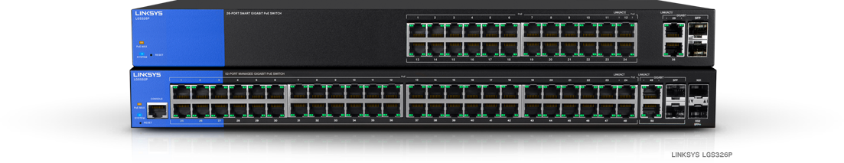
Data Link Layer (Switches)
What’s a switch?
Layer 2 Switches are devices used for local communications on a network and cannot communicate with other networks
Uses MAC addresses to create a lookup table of devices
Devices announce mac address and switch builds a table
Looks like this:
Notes:
Devices announce mac address and switch builds a table

Slide 16
Network Layer
Often referred to as Layer 3
IP addresses reside here (192.168.1.1 is probably familiar to a lot of you)
Handles communications across networks
What does IP mean?
IP - Internet Protocol
Two different versions, IPv4 and IPv6
IPv4 most heavily used.
Year of IPv6 is about as likely as the year of the Linux Desktop
We’ll only focus on IPv4 today

Slide 17
Network Layer (IPv4)
IP address: 32 bit number that represents either a single machine or network.
Split into 4 - 8 bit segments (e.g. 192.168.3.5 )
IP addresses range from 0.0.0.0 to 255.255.255.254
Networks consist of a range of these IP addresses
ARP maps IPs to MAC addresses at Layer 3 in a lookup table
Due to organizational reasons and to limit broadcast domains, networks are broken up into subnets
Notes:
Dont want tons of machines broadcasting on the same network

Slide 18
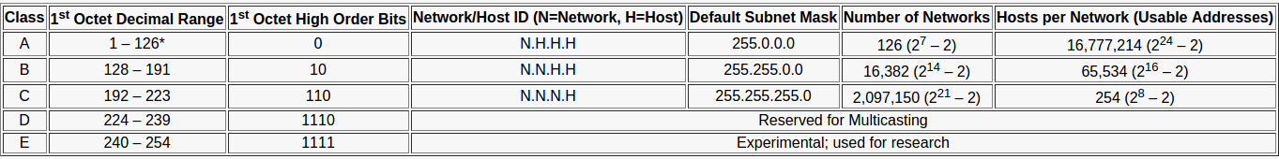

Network Layer (IPv4 Classifications)

Slide 19
Network Layer(Networks)
To have a network that can communicate with other networks, you need to have a few things:
Gateway: Address of a router that can talk to other networks
Netmask: Specifies the size of your network
Network Address: First address in your network, usually ending in .0
Broadcast Address: Used for discovering new devices on a network
Normal IP Addresses
Protocols like RIP, BGP, and OSPF determine routes between hosts

Slide 20
Network Layer (IPv4 NAT)
NAT - Network Address Translation
Necessary due to the limited number of IPv4 addresses
One IP address bound to many
If you look at your IP address on your computer, it’ll be different from what it shows up as on https://whatsmyip.com
Router keeps table of active connections to track which local IP initiated a connection with which remote IP
Uses something called port forwarding to allow inbound connections through the NAT.

Slide 21
Switches vs Routers
Switches operate at Layer 2 (MAC Addresses)
Routers operate at Layer 3 (IP Addresses)
“Layer 3” switches are just a marketing term that mean faster but less featured routers that also handle switching functionality
Home routers are a combination of routers, switches, and wireless access points.

Slide 22
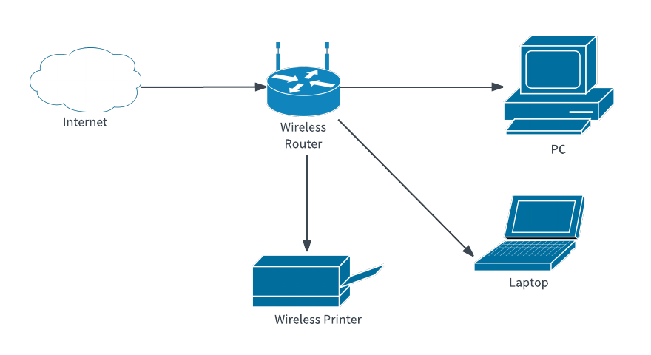
Network Layer(Home Net Example)
Public IP: 105.8.9.20
Private IP: 192.168.1.1
Private IP: 192.168.1.50
Network Config:
Gateway: 192.168.1.1
Netmask: 255.255.255.0
Network:
192.168.1.0
Broadcast 192.168.1.255
Private IP: 192.168.1.101
Private IP: 192.168.1.33

Slide 23

Interactive Content
Notes:
Start at 3:26

Slide 24
Transport Layer
Handles putting data into packets, determining the size of the packets
Decides how much data to send
Determines what ports to send data to and from
What’s a port?
A number between 1 and 65535 that represents an exposed process on a system
Allows data to be transferred to and from an application on a network
Example: HTTP Servers run on port 80. HTTPS Servers run on port 443. (by convention)
Two standard protocols:
TCP and UDP

Slide 25
Transport Layer(TCP)
TCP stands for Transmission Control Protocol
“Connection Oriented” meaning that connections are established and maintained until the end of a data transfer
Uses a 3-way handshake to negotiate connections
Used in applications where data integrity is important, such as SSH connections, Web Form submissions, etc.
If a packet is lost, it’s resent
Headers range between 20 and 40 bytes
What’s a header?
All the necessary metadata about a packet

Slide 26
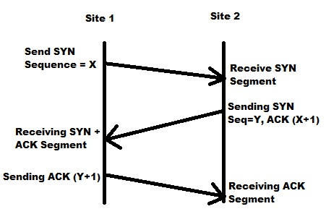
Transport Layer(TCP)

Slide 27
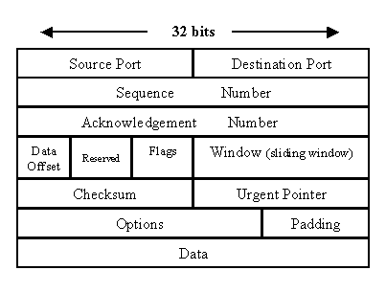
Transport Layer(TCP)
Notes:
Source Port: Where a connection is originating from
Destination Port: Where a connection is going to
Sequence Number: A tracker of which packet number this is, for when you have to transfer a sequence of packets
Data Offset: Just contains the size of the packet header
Reserved: Not important to know, just makes sure that the packet size is a multiple of 4 bytes
Flags: Series of flags that have information about the current connection state
Window: How much data to send before receiving an acknowledgement
Checksum: 1’s complement of the packet to check the integrity of the data
Urgent Pointer: Usually set to zero, but indicates a packet that needs to be processed immediately
Padding: Just contains a bunch of 0s to ensure the header is the right size
Data: Your actual content

Slide 28
Transport Layer(UDP)
UDP stands for User Data Protocol
Used in applications where connection integrity isn’t so important, such as video streaming, where it’s ok if packets are lost
Much smaller header size of only 8 bytes.

Slide 29
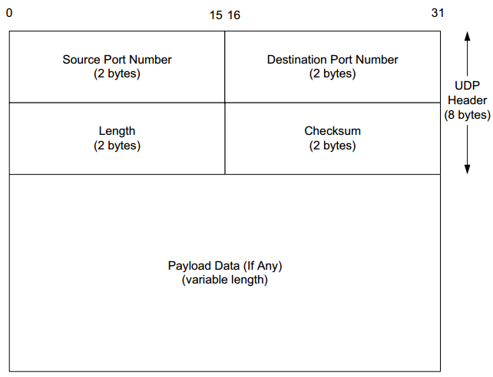
Transport(UDP)
Notes:
Sourt Port: Port from where connection originates
Destination Port: Port where data is going
Length: Has the total size of the packet, including the headers
Checksum: 1’s complement of all the data to ensure packet integrity

Slide 30
Session Layer
Handles when to setup connections between two different services
Handles terminating sessions
Examples:
Tracking downloads from an FTP Server (Just a server that you can upload files to and download files from)
Tracking telnet connections (telnet is like ssh except shittier and unencrypted)

Slide 31
Presentation Layer
Transforms data to and from something that is readable by applications and the network.
Example is encrypting and decrypting data for transport (SSL and TLS)

Slide 32
Application Layer
Top layer and the layer that end users actually interact with
Encapsulates both programs and protocols
Examples:
Protocols: DNS, HTTP, HTTPS, FTP
Applications: Google Chrome, Firefox, Skype, etc.

Slide 33
Fundamental Protocols(DNS)
DNS - Domain Name System:
Handles domain name mappings
What’s a domain?
Top level domain:
*.com, *.org, *.edu
Subdomains:
Primary Domain: google.com
Secondary: cloud.google.com
Notes:
DNS is like a phonebook. It’s a listing of names and addresses matching to a phone number

Slide 34
Fundamental Protocols (DNS)
Multiple types of records:
A Record - Maps an IPv4 Address to a domain name.
Example: cse.sc.edu maps to 129.252.138.12
CNAME Record - Maps one domain name to another
Example: Facebook.org maps to Facebook.com
MX Record - Maps a mailing address to a mail server
Example: google.com’s mx record maps to aspmx.l.google.com.
PTR Record - reverse lookup. Find a domain name based on ip address
Example: 129.252.138.12 maps to dwight.cse.sc.edu
Note: These addresses are different sites (Shared hosting)
TXT - can hold arbitrary strings. Often used for things like checking domain name ownership for issuing TLS certificates to enable HTTPS on websites
More examples found here: http://dns-record-viewer.online-domain-tools.com/

Slide 35
Fundamental Protocols(HTTP)
HTTP stands for Hypertext Transport Protocol
All websites use this or HTTPS
Stateless protocol, meaning it just cares about the command you’re getting right now, which is why RESTful applications are so popular
Any state tracking has to be done by the web application that’s driving it.
Two most important methods:
GET - retrieve data from a website
POST - send data to a website

Slide 36
Fundamental Protocols(HTTPS)
Like HTTP, except encrypted with either SSL or TLS
Most browsers show a green lock to indicate the page is secure
What’s SSL and TLS?
TLS is a protocol for encrypted communications
Uses asymmetric encryption for key negotiation and then symmetric encryption after a symmetric key is established
Google ‘Diffie Helman Key Exchange’ if you’re interested

Slide 37
Fundamental Protocols (DHCP)
DHCP stands for Dynamic Host Configuration Protocol
DHCP server tells clients that connect to a network what their IP address is, what the gateway is, what their primary and secondary dns servers are, the subnet mask, and any information needed to make the network usable
Makes the lives of network admins and end clients 1000%$ easier
Don’t have to tell a client how to configure their network. Just give them a port to plug into or a wire

Slide 38
Firewalls
Firewalls handle access restrictions and filtering between networks
Simple Firewalls:
Block access to specific ports
Block access between certain networks
Block certain connection states
Allow traffic to be initiated in one direction but not the other
Dynamic Firewalls:
Drop or reject connections based on packet contents (packet fingerprinting)
Detect malware on a network
Detect intrusion attempts

Slide 39
Network Tools
nslookup/dig/host - find the IP address for a DNS address
Nmap - the golden standard for network mapping
Ping - see if a host is available
TCPDump/Wireshark - show incoming and outgoing packets
Netcat - host or client for network service
Ifconfig - change network configuration
IPTables/firewalld - set firewall rules
Route - show and edit routing tables
Netstat - show active services (local and network)
Arp - show and edit ARP cache
Notes:
Tell Bakos story about netcat

Slide 40

Interactive Content

